Slide 1

Lesson 1 Practice Hands-On
Modeling with linear regression
By: Tameka Gillett

Slide 2
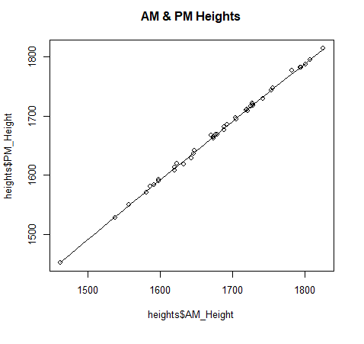
Testing for Assumption / Linearity
scatter.smooth(x=heights$AM_Height, y=heights$PM_Height, main="AM & PM Heights")
This is a nice a smooth line with an upward trend

Slide 3
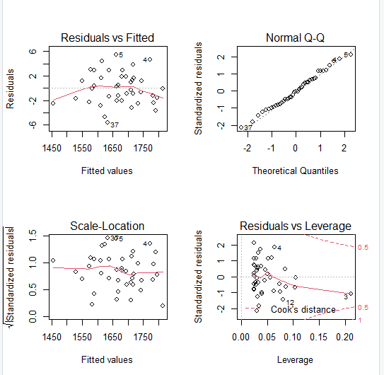
Linear Model & Homoscedasticity Test
Scale-Location and Normal Q-Q are the ones I will continue with
# Creating a Linear Model
lmMod <- lm(PM_Height~AM_Height, data=heights)
# Homoscedasticity test
par(mfrow=c(2,2))
plot(lmMod)

Slide 4
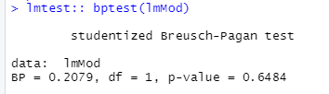

More Homoscedasticity Tests
Since the p-value are 0.6484 and 0.6967, which are both greater than .05, we have met the assumptions of heteroscedasticity.

Slide 5
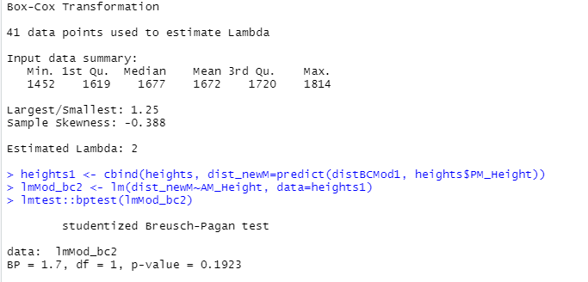

Box-Cox transformation
This is violating the assumption of homoscedasticity because the p-value is less than .05.

Slide 6
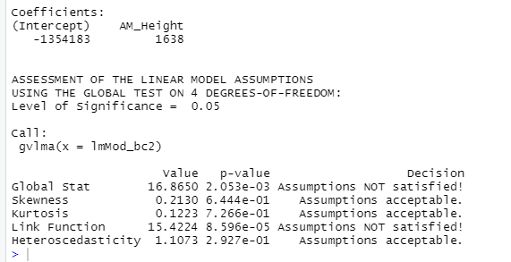







Testing for Homogeneity of Variance
Remember our initial linear graphs
Skewness: This is a measure of whether your data is normally distributed horizontally.
Kurtosis: This is an indicator of whether your data is normally distributed vertically.
Heteroscedasticity: This is an indicator of whether your residuals are constant. If you fail this, you fail the assumption of homoscedasticity.
gvlma(lmMod_bc2)

Slide 7
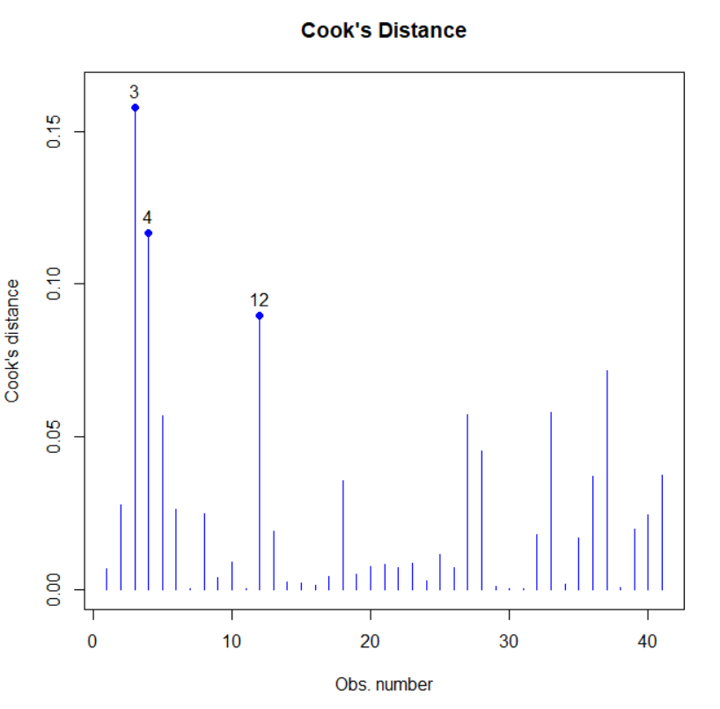




Testing for Outliers in X Space
The outliers are 3, 4 and 12
CookD(lmMod, group=NULL, plot=TRUE, idn=3, newwd=TRUE)

Slide 8
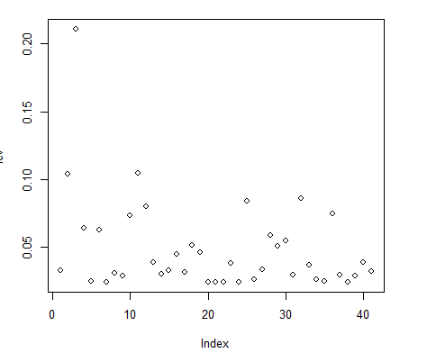


Test for leverage
We have outliers in x space
Unfortunately, we have one over 0.2
lev = hat(model.matrix(lmMod))
plot(lev)

Slide 9

Bonferroni
We do not have any outliers in y-space because Bonferroni p-value is NA

Slide 10
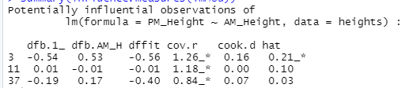






Testing for Outliers in x and y Space
No influential outliers in the data

Slide 11
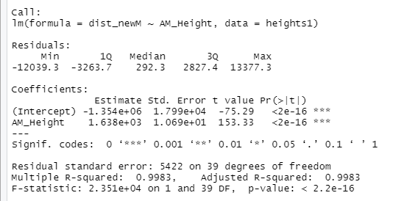
Interpreting Output
P-value is not significant leading us to believe that there isn’t a different between AM and PM.

Slide 12
Original Theory
It is a well-known phenomena that most of us shrink throughout the day each day. The effects of gravity cause that our height measured at the end of the day is less than our height measured at the beginning of the day. Fortunately, at night, our bodies stretch out again, so that from one morning to the next, each of us has returned to the morning height from the day before.

Slide 13
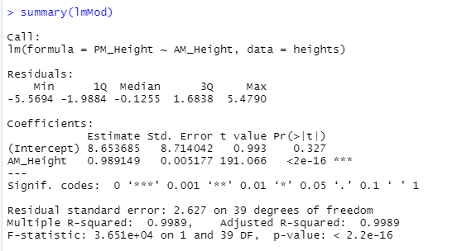
Interpreting Non-Transformed Regression Output
According to our data, for every 1 AM, there would be a .99 increase.
That’s a huge chunk of significant data so the theory is correct.

Slide 14
Coding in R
# lOAD IN lIBRARIES
library("car")
library("caret")
library("gvlma")
library("predictmeans")
library("e1071")
library("lmtest")
# Test for Assumptions/Linearity
scatter.smooth(x=heights$AM_Height, y=heights$PM_Height, main="AM & PM Heights")
# Creating a Linear Model
lmMod <- lm(PM_Height~AM_Height, data=heights)
# Homoscedasticity test
par(mfrow=c(2,2))
plot(lmMod)
lmtest:: bptest(lmMod)
car::ncvTest(lmMod)
distBCMod1 <- caret::BoxCoxTrans(heights$PM_Height)
print(distBCMod1)
heights1 <- cbind(heights, dist_newM=predict(distBCMod1, heights$PM_Height))
lmMod_bc2 <- lm(dist_newM~AM_Height, data=heights1)
lmtest::bptest(lmMod_bc2)
# Testing for Homogeneity of Variance
gvlma(lmMod_bc2)
# Testing for Outliers in X Space
CookD(lmMod, group=NULL, plot=TRUE, idn=3, newwd=TRUE)
# Test for leverage
lev = hat(model.matrix(lmMod))
plot(lev)
heights[lev>.2,]
car::outlierTest(lmMod)
summary(influence.measures(lmMod))
# Interpreting Output
summary(lmMod_bc2)
# Interpreting Non-Transformed Regression Output
summary(lmMod)

Slide 15

Coding in Python

Slide 16
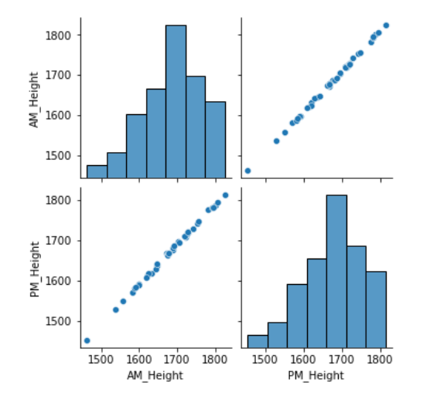
Testing for Linearity and Normality

Slide 17
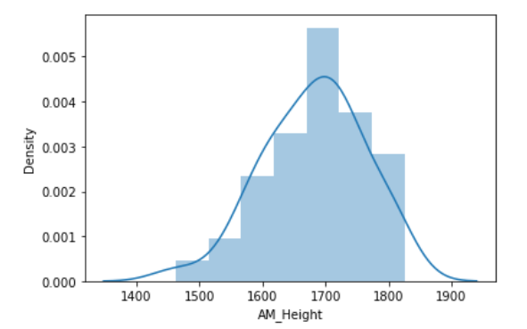
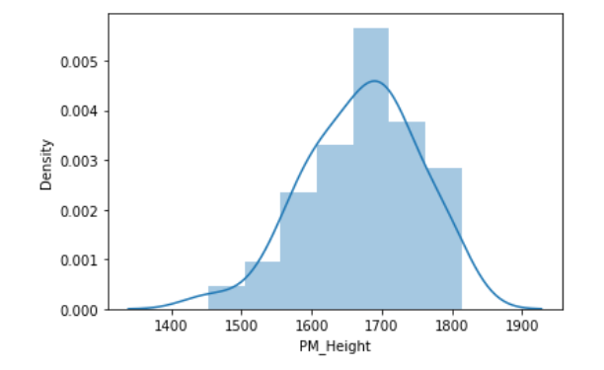
Difference between AM & PM These variables are normally distributed
AM
PM

Slide 18
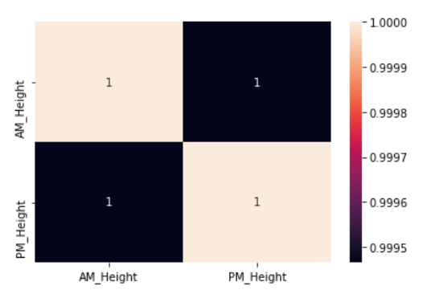
Heat Map

Slide 19
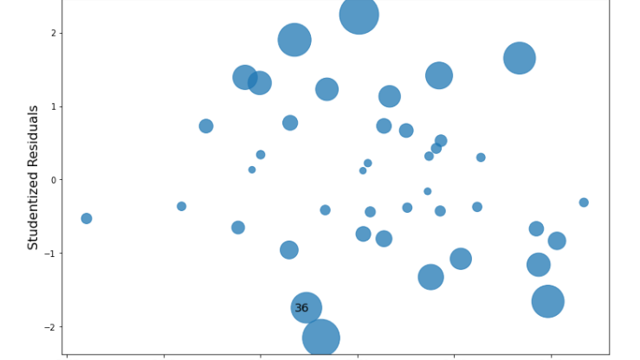
Screening for Outliers again

